Slide 1
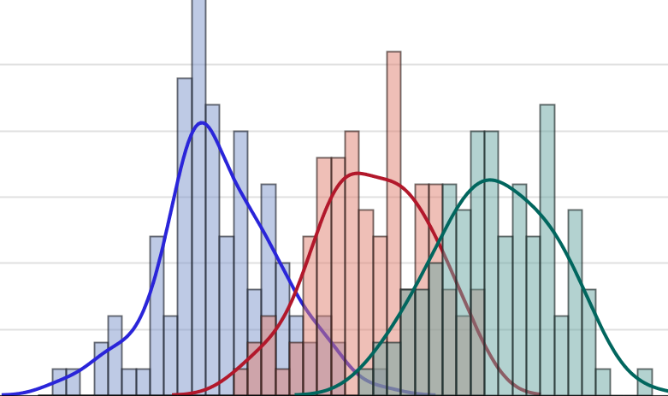

Effectively Using Figures To Present Results
Introduction to Data Management and Statistical Computing
Notes:
Fade in for 3 seconds. No music

Slide 2
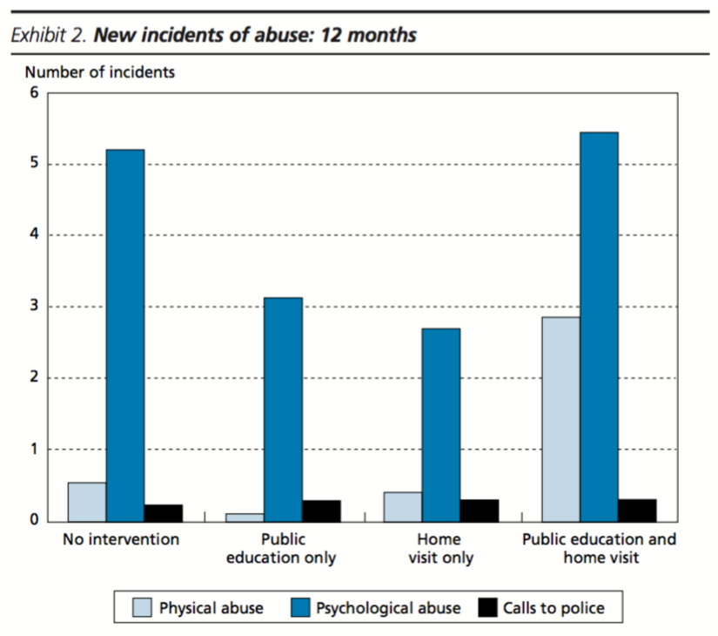
Notes:
Bad figure. Doesn’t stand alone. Can’t figure out the y-axis. How can a count of incident reports take on non-integer values?
Davis - Results from an Elder Abuse Prevention Experiment in New York City

Slide 3
Outcome Vs. Predictor

Slide 4
What do you mean by Figure?
The general term “figures” encompasses all the graphics that are not tables.
Show examples of scatter plot, line graph, bar graph, flowchart, pictograph, pie chart, scatter plot, histogram, box plot, logic model, DAG, Photographs

Slide 5
Why do we use figures?
They summarize and emphasize key points and reduce narrative length. They simplify information and in this way enhance understanding. They improve the conciseness and clarity of the narrative. And finally, when carefully crafted, they add visual appeal.
And in public health, helping others visualize data - and its accompanying implications is an essential part of your job.
Tables present results; graphs promote understanding of results and suggest interpretations of their meaning and relationships. Most graphs are based on a set of numbers, just as most tables are. But, because graphs are fundamentally pictures rather than a set of numbers, information generally is easier for the reader to grasp than if it were printed in columns.
Consider graphing data when you feel that the relationships are more vital to your message than the actual numerical values themselves.
A graph always shows how one parameter varies relative to changes in another.
Temperature and time in these examples are independent variables, which are usually plotted in relation to the horizontal (x)-axis. The effect these changes have on something else (the dependent variable) is normally plotted in relation to the vertical (y)-axis.

Slide 6
Consider intended audience
For a presentation to a group of specialists in your field, a logarithmic graph might be a perfectly appropriate way to back up your story, but showing the same figure as part of a talk to non-scientists could be confusing.

Slide 7
When should I use a figure?
Use figures when one will make your point more successfully than the text or a table would.
Three E’s
Evidence
Efficiency
Emphasis

Slide 8
How to lie with figures
Show an example of how you can make essentially no differnece apear large by changing scales, and vice versa.
Look for additional specific guidance on choosing a scale for charts.
Never finagle line fits, delete data points that do not fit the curve, or make data points so large that almost any curve would pass through them. Begin at zero for the scales used for the axes of a graph whenever possible; choose these scales carefully and mark them clearly. Sometimes, a valid trend would disappear on a scale with a zero axis, and all the data points would bunch up at the top. In this case, signal readers that the graph’s axis is not at zero, either with a statement in the text or with a break in the axis. If a point represents the mean of a number of observations, indicate the magnitude of the variability by a vertical line centered at each point. State whether standard error (SE) or standard deviation (SD) is used and specify number of observations or sample sizes.
When two or more graphs or other figures are to be compared, draw them to the same scale. Then, if possible, group them into a single illustration. To minimize reduction during printing, place them one above the other rather than one beside the other. Remember the limitations of your data. The extrapolation of a line or a curve beyond the points shown on a graph may mislead both the writer and the reader. As Winston Churchill is said to have remarked in another context, “It is wise to look ahead but foolish to look further than you can see.”

Slide 9
Line Graphs
Line graphs show continuous variables, such as movements over time.
If you decide to use line graphs, keep them as simple as possible. Limit the number of lines in any one graph. Visually distinguish different lines by using different symbols, and label each line carefully. To avoid giving a false impression, do not connect graph points for discontinuous data. Instead, present such information as a bar graph or leave the points on the graph without connecting lines.

Slide 10
Bar Graphs
Bar graphs, also sometimes called column graphs, are used to present discrete variables in a visually forceful way. They are a single axis graph used to compare size and magnitude of discontinuous data. They are superior to circle and line graphs for showing relationships, magnitudes, and distributions
The bars may run either vertically or horizontally, but are most effective when they run in the direction in which people expect to see them. Thus, vertical bars are usually used for such data as temperature and weight, horizontal bars for distance, time, and speed. Whatever type of bar graph you choose, make the bars the same width, and the space between bars or bar groups about one-half of a bar width.

Slide 11
Pie Charts
Divided-circle graphs (Fig. 8.1), also called pie charts, are well suited for showing the relationship of a number of parts to the whole.
In the three-dimensional exploded pie slice at left, pollen pellets from roses appear almost as numerous as those from violets. In reality, the percentage of pollen petals from violets was almost twice that from roses, as the two-dimensional graph clearly shows.
Can also use stacked bar charts. These have the advantage of aiding comparisons because they are on the same scale.
Notes:
Compare the 3D chart to the 2D pie chart. Much easier to see differences in sizes.

Slide 12
Pictographs
Pictographs, which are essentially bar graphs composed of pictures, can be very visually effective.
Perhaps because their construction historically has fallen within the domain of graphic artists, pictographs rarely appear in scientific writing, though they might provide welcome variety.
They are especially appropriate and effective for illustrating oral and poster presentations.
Pictographs are most effective when the symbols chosen represent the subject matter and are arranged in a way that presents a clear, organized message. Once again, take care to ensure that the artwork is not potentially misleading.
Notes:
Gaining popularity in reports created for consumption by general audiences. Has been slower to catch on in scholarly journals.

Slide 13
Cheat Sheet
Purpose | Figure
To present exact values, raw data, describe groups, or present results that do not neatly fit into figures | Table, List
To summarize trends over time, or highlight the relationship between variables over time. | Line Graph
To highlight differences between discrete categories | Bar Graph, Pictograph
To describe parts of a whole | Stacked Bar Graph, Area Chart, Pie Chart
To show a sequential process, or describe a hierarchy, within an object, idea, or organization | Flow Chart
To describe a change of state | Line Graph, Bar Graph
To describe causation | Diagram, Directed Acyclic Graph (DAG)
Adapted from: Matthews JR, Matthews RW. Successful Scientific Writing: A Step-by-Step Guide for the Biological and Medical Sciences. Cambridge University Press; 2014.
Notes:
Also mention that this is not all inclusive. It only covers some common scenarios encountered in the health sciences, and if you look around, you can likely find exceptions to each of these suggestions.
Give examples as you go through this?

Slide 14
Maps
States are an interesting paradox. This is an instance when you would likely want to present them alphabetically in a table because that is how people are used to seeing them organized. However, regional trends are much more clear when presented as a map than as a table.
Use obesity epidemic as an example.

Slide 15
Chart junk
May want to touch on this. Also, point out that most journals don't allow colored charts.
Is this true of online journals?

Slide 16
Demonstration
Calculating Pearson’s Correlation Coefficient in SAS

Slide 17
Practice: Calculating Pearson’s Correlation Coefficient
The data set hsb contains data from a large-scale longitudinal study conducted by the National Opinion Research Center (1980) under contract with the National Center for Education Statistics. The students in the study are a nationally representative sample of n=600 high school seniors. You will investigate the relationship between two continuous variables representing standardized mean reading and writing test scores.
Steps:
Open the SAS program named m8.1_lecture_practice_PROC CORR
Use a SET statement in a DATA step to read hsb1.sas7bdat into your work library
Use the SGPLOT procedure to graphically investigate the relationship between the variable read and the variable write. What does the relationship between read and write appear to be?
Write a PROC CORR step to investigate the relationship between read and write. Do the results change your previous conclusion?

Slide 18
References
Matthews JR, Matthews RW. Successful Scientific Writing: A Step-by-Step Guide for the Biological and Medical Sciences. Cambridge University Press; 2014.
Journal Articles

